Slide 1
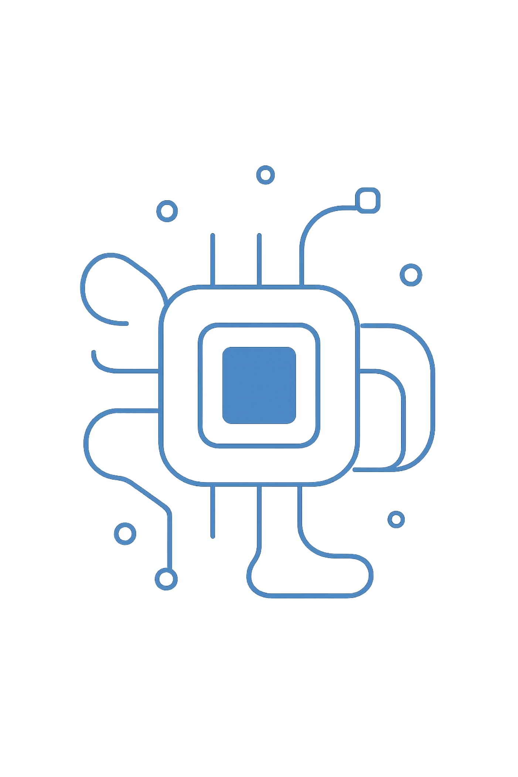
Platform Technologies
Hardware + Software + Networks = Platform
A platform is any base of technologies on which other technologies or processes are built. Most services end users interact with are built on top of platforms.
BASED ON TANENBAUM, MODERN OPERATING SYSTEMS & MANAGEMENT INFORMATION SYSTEMS

Slide 2
Generations of Computing
1945–55
1
Vacuum Tubes — Punch cards & machine language
2
1955–65
Transistors & Batch Systems — IBM 1401, IBM 7094, FORTRAN
1965–80
3
ICs & Multiprogramming — IBM System/360, MULTICS, timesharing
4
1980–Present
Personal Computers — IBM PC, DOS, Macintosh, Windows, Linux
1990–Present
5
Mobile Computers — PDAs, Blackberry, iOS, Android

Slide 3
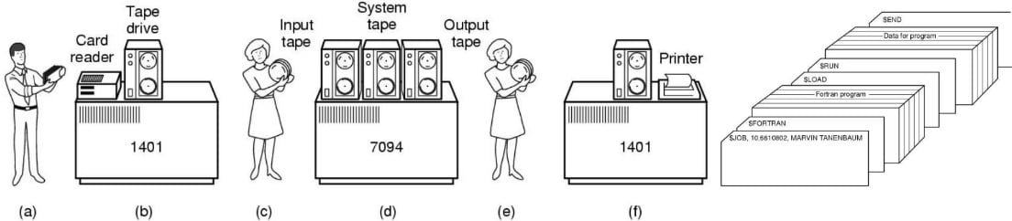
Early Computing Systems
Batch Processing (1955–65)
Programmers submitted punch cards to the IBM 1401, which read jobs onto tape. The IBM 7094 performed computation, then output tape returned to the 1401 for printing.
Multiprogramming (1965–80)
Multiple jobs (Job 1, 2, 3) occupied separate memory partitions alongside the OS, enabling timesharing and improved CPU utilization.

Slide 4
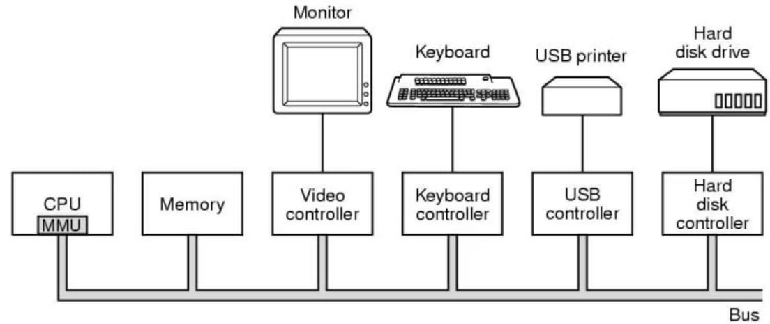
Modern Computer Architecture
Core Components
A modern computer consists of processors, main memory, disks, and I/O devices — all connected via a system bus (control, address, data).
Hardware Architecture Types
Commodity computing platforms
RISC, Mainframes, Supercomputers
Video game consoles, Midrange computers
Managing all components requires the operating system.

Slide 5
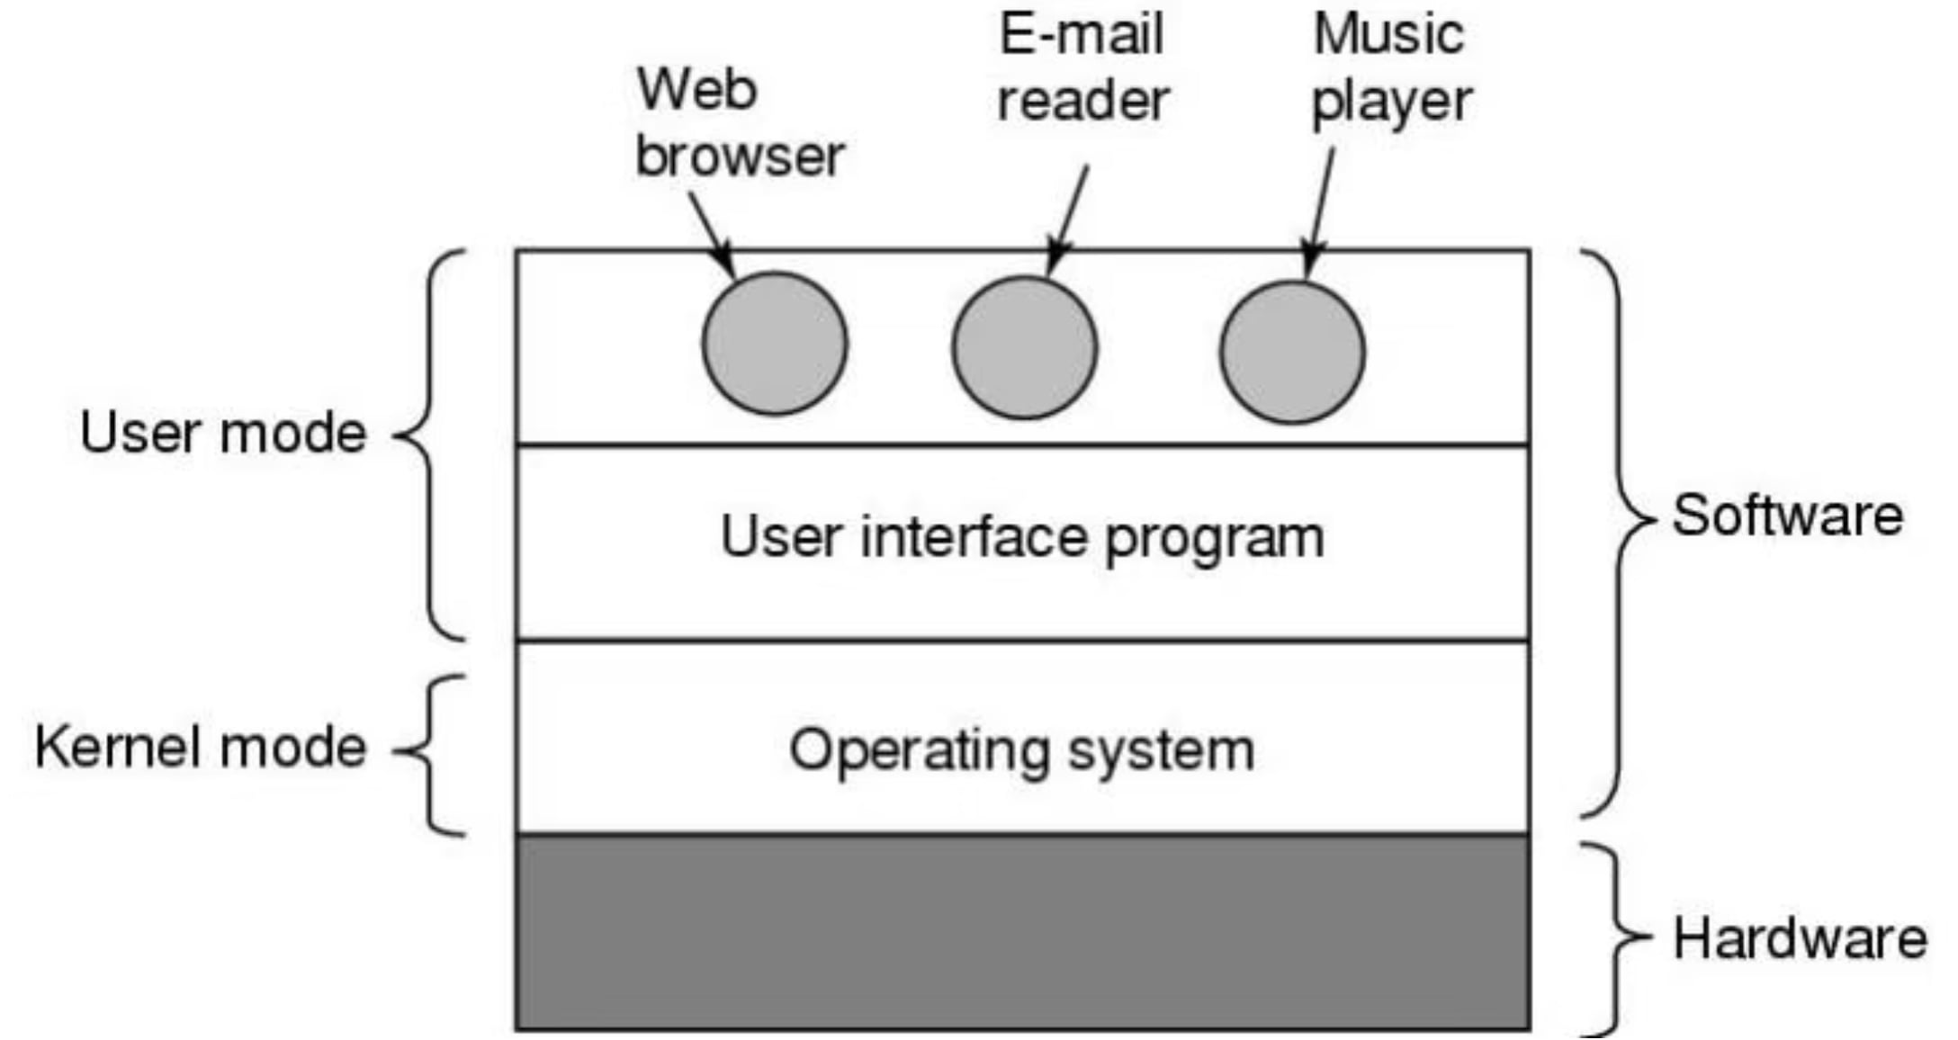
What Is an Operating System?
Resource Manager
Extended Machine
Intermediary
Manages CPU, memory, and disk — the most important program on any computer, loaded first.
Turns ugly hardware details into beautiful abstractions for application programs.
Acts between users and hardware, simplifying complexity of running applications efficiently.

Slide 6
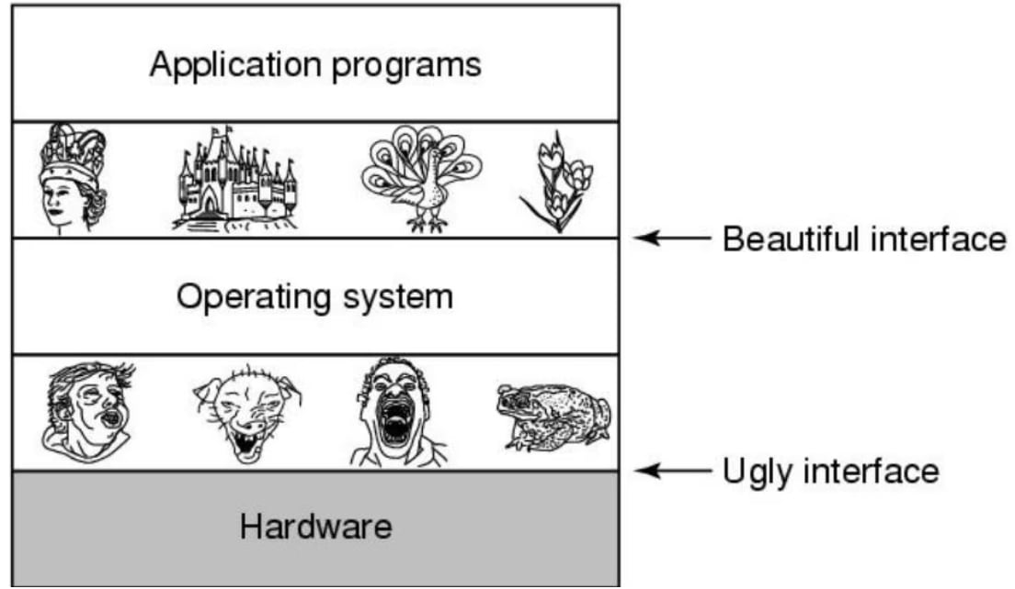
OS Concepts & Architecture
Key Concepts
Processes — address spaces, files, I/O, protection
Multithreading & Multicore — shared vs. private L2 cache architectures
Memory hierarchy — registers → cache → RAM → disk
I/O Devices — input, output, or both (e.g., touchscreen, modem)
OS Types
Mainframe, Server, PC, Handheld, Embedded, Real-time, Smart card, Sensor node

Slide 7





Evolution of IT Infrastructure
Mainframe Era
PC Era
Client/Server
1959–present
IBM mainframes (1958), DEC minicomputers (1965)
1981–present
IBM PC introduced; proliferation of personal software
1983–present
Desktop clients networked to servers; 2-tier to N-tier
Enterprise
Cloud & Mobile
1992–present
Integrated networks using Internet standards
2000–present
Computing power & software delivered over the Internet

Slide 8
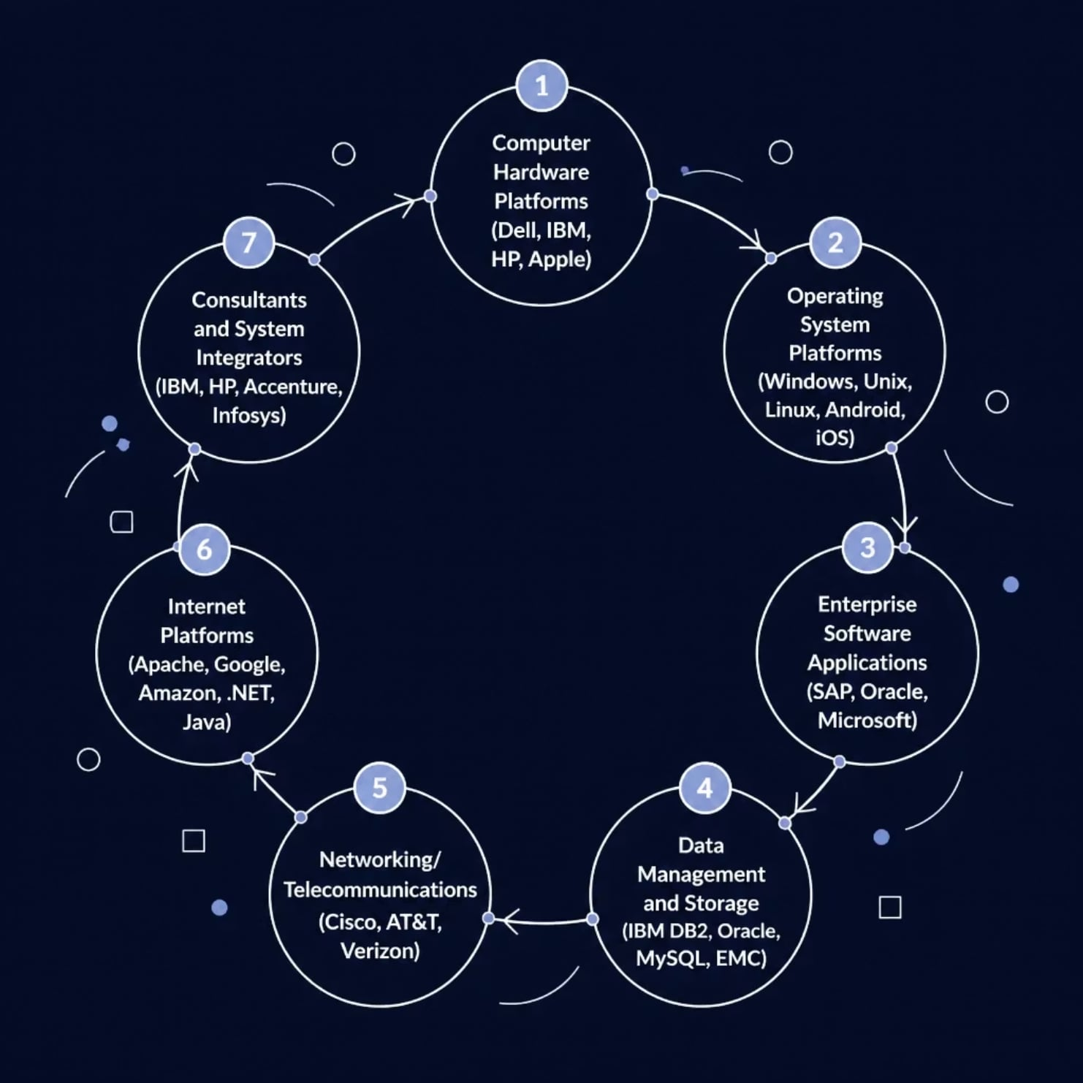
IT Infrastructure: 7 Components
The IT Infrastructure Ecosystem
Seven interconnected components form a complete ecosystem — from hardware and OS platforms to networking, data storage, enterprise software, Internet services, and consulting/integration providers.

Slide 9
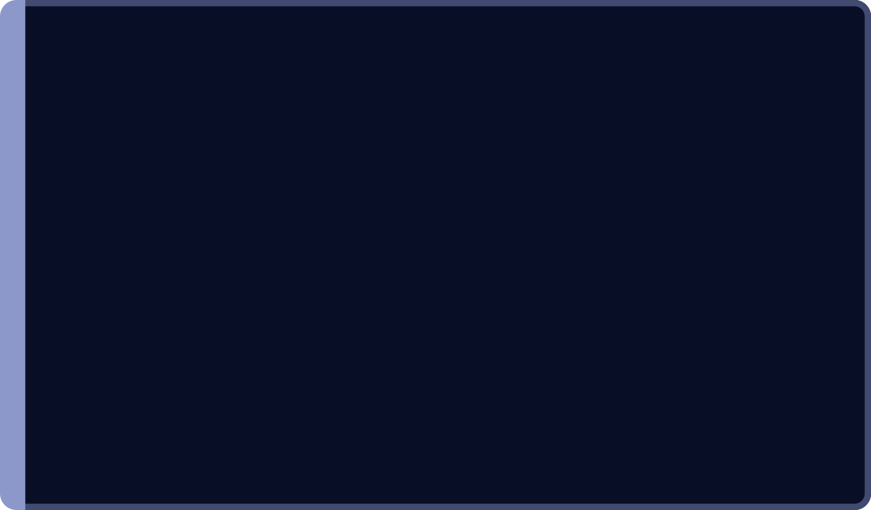

Infrastructure Components: Detail
Hardware Platforms
OS Platforms
Data Management
Desktops, laptops, blade servers, mainframes. Top producers: Intel, AMD, ARM. Top firms: IBM, HP, Dell, Lenovo.
Server: 65% Unix/Linux, 35% Windows. Client: 90% Windows; mobile (Android, iOS); cloud (Chrome OS).
Databases: IBM DB2, Oracle, SQL Server, MySQL. Storage: EMC, Seagate. SANs connect storage on dedicated networks.
Networking & Internet
Consulting & Integration
Telecom: AT&T, Verizon. Network hardware: Cisco, Juniper. Internet services: Amazon, Google. Web tools: .NET, Java, Adobe.
Accenture, IBM, Infosys, Wipro integrate new infrastructure with legacy systems.

Slide 10
Module Outline & Resources
Module Topics
Module Resources
Introduction
Processes
Scheduling
Data Communication & Networking
File Systems
Distributed Systems
Virtualization & Cloud Computing
Platform Security
Client Server Architectures
System Administration
Lecturer: Nimal Skandhakumar
nimal@sjp.ac.lk
0769804524
LMS Course:
lms.fhss.sjp.ac.lk/course/view.php?id=1406

